Slide 1
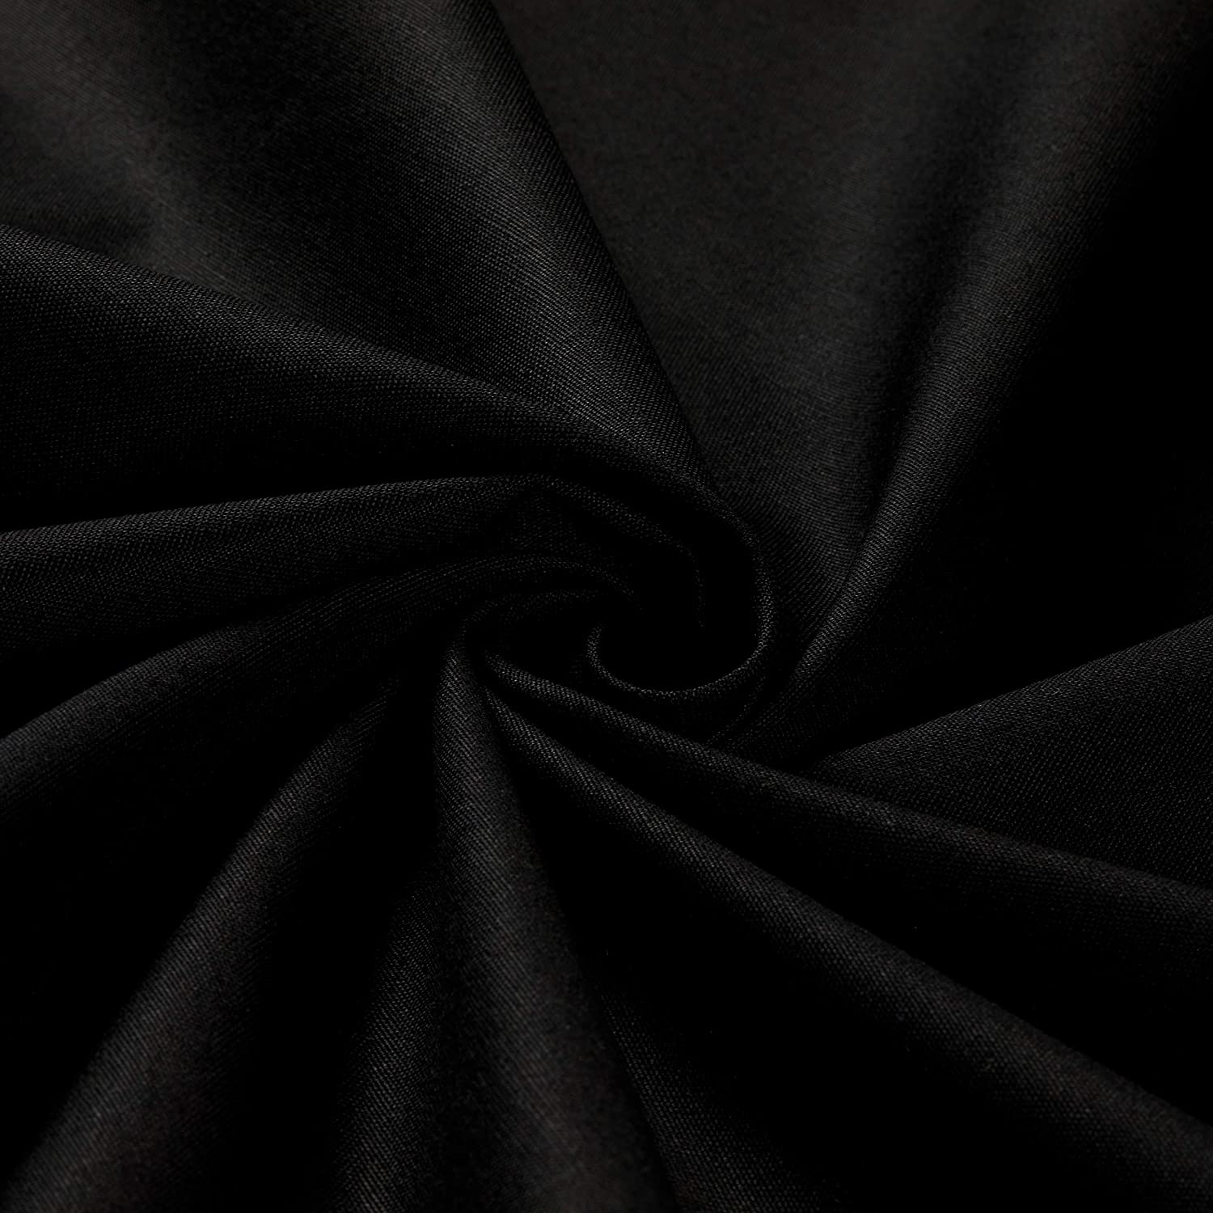
Police
POLICE BODY SIZE
PBS Fashion Company Limited

Slide 2
Table of content
History
Brands and outlets
Difference from Market and our worth
Road Map
Marketing strategies
Why you choose us
How to Contact Us

Slide 3
History of police
PBS
POLICE BODY SIZE
PBS Fashion Company Limited
Previously called Kurobo Co. ltd was established in 1983 by Sinthorn Thangapiwattana and registered trademark “POLICE INTERNATIONAL & DEVICE” in 13th of January 1984. The business is under the brand name “POLICE” which started with T-shirts, trousers and suits until the year 1994. We scoped down to focus on men T-shirts and underwear.
In 1999 we started to expand our business from domestic to international market. Our export agency was located at Pratunam Market, one of the biggest market in Thailand. We had excellent experience and feedback especially from Asia Middle East and Africa. In Africa market such as Nigeria, Ghana, Kenya and South Africa costumers have high Preference on our products regard on reasonable prices elegant designs and quality.

Slide 4
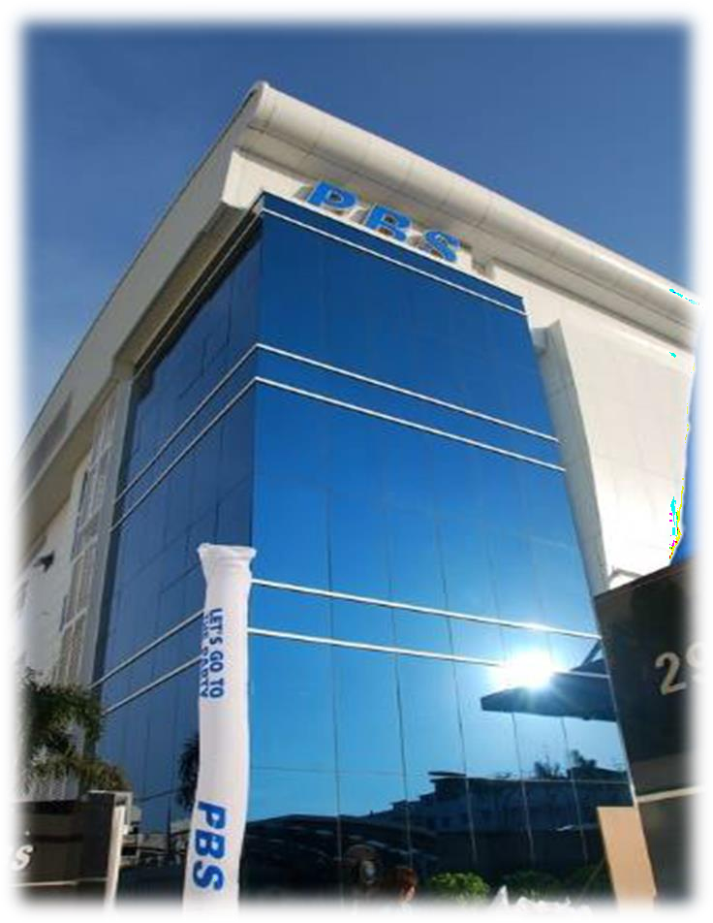
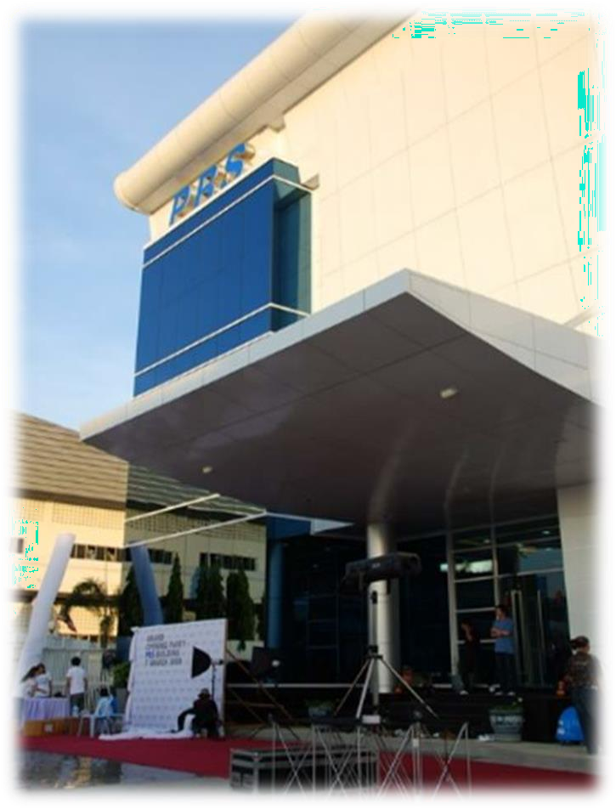
Till 2022 PBS Fashion company “POLICE” has expanded its business to over 60+ countries operating from THAILAND.

Slide 5
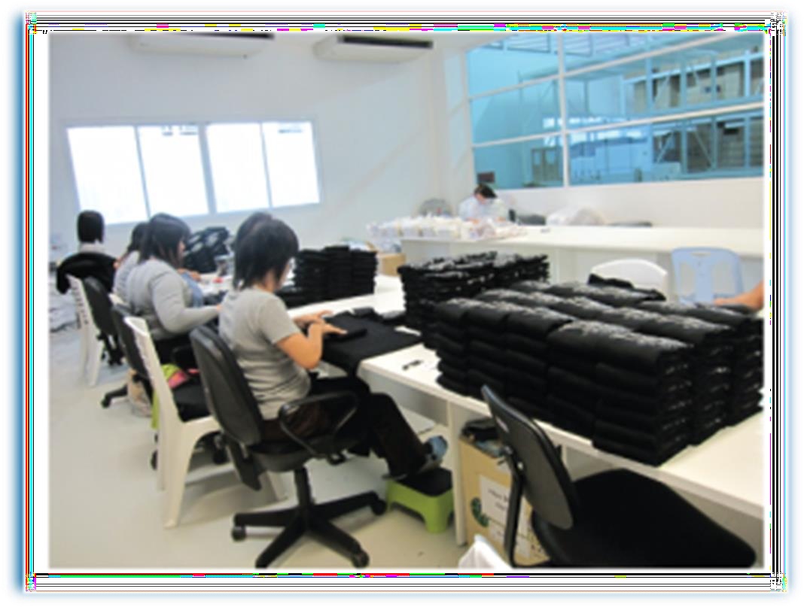
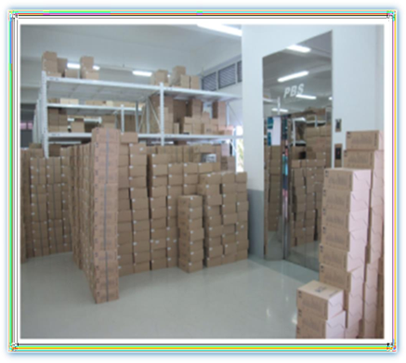
Back of the house
To give quality product quality processing and environment play a major role, which has been excellently managed by the PBS team
Raw material storage
Packing Products
Stock warehouse

Slide 6
Our brands
According to demand and needs POLICE International always tries the best to satisfy their costumers by adopting social change and providing unique designs and articles. Now PBS is working in more than 6 brands
POLICE BODY SIZE
PBS Fashion Company Limited

Slide 7
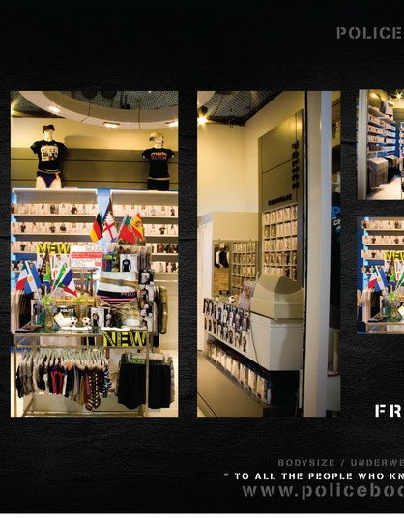
OUTLETS:
Retail outlets allow customers to see what they are buying up close and, as opposed to online stores, they provide instant gratification, because the customer walks away with their purchases immediately. A friendly and helpful staff also helps to build customer loyalty, ensuring that customers return again and again so Along with the excellent production processing and following best supply chain procedures PBS team is also very concern about their outlets.

Slide 8
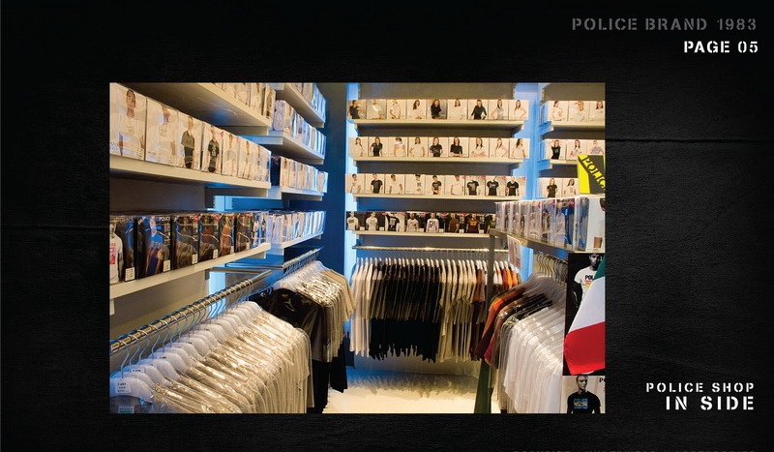
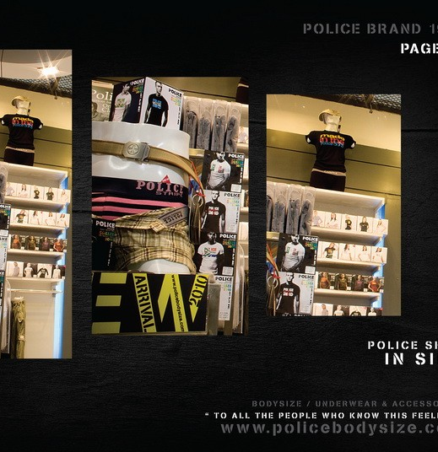
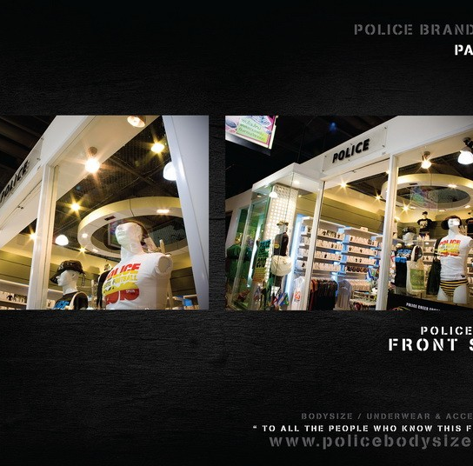
Showrooms

Slide 9
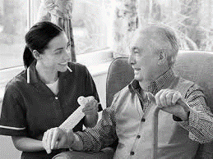
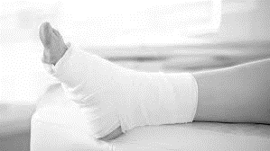
What make us different
PBS management are experts to buy best quality of raw material. We use 100% cotton, Our company uses Supima Cotton (superior Pima) and Egyptian cotton for our fashion line products
And not even that our company don’t use such chemical for production which can harm human health such as
Dimethylformamide found in acrylic fabrics
Azo dyes used to color clothes
Phthalates found in plastic raincoats, fake leather and waterproof clothing
Nano silver used in clothes marketed as antimicrobial
Moreover, our consumer never have respiratory issues and diabetic wounds patients can use our products

Slide 10
Company achievements and worth
PBS Ltd.co is growing day by day worldwide

Slide 11
Roadmap
We have recently expanded our product line under the name “POLICE ZEBRA”, which focus on casual and trendy lifestyle products examples: T-Shirt, Polo, Jeans and Shorts.
For the future plan, our vision is to expand the products to the new markets such as Jordan, Russia and The Scandinavia and also to improve fashion line article quantity
We are now going increase the number of outlets and creating some new (where needed) to delivery best price and promotions to costumers
Going to launch a website and app, where costumer can modify design and color of choice for their order

Slide 12
Marketing strategy
Marketing is a tool to make sure that you have all the right systems in place. By marketing company can grow sales, can know what you costumers need.
Our company spend major part of income on marketing plans but now are have new strategies in pipeline

Slide 13
Why Choose Us ?
- We are among the best companies in the world
- Our products are very comfortable and durable that’s why our costumers choose us
- Our products occupy less space due to its packing
- We have all legal documentation to work in country
- We can offer special promotion items
- Ready to do businesses with you on your conditions
- In Garments we sell 100% pure cotton products.
- we can get you the direct shipment from mother company

Slide 14
MEROOJ TRADING C.O L.L.C
P.O. BOX 12326, Dubai
+971503635006
+971564167666
+97142552155
Policebodysize.ae@gmail.com
https://www.policebrand.ae/

Slide 15
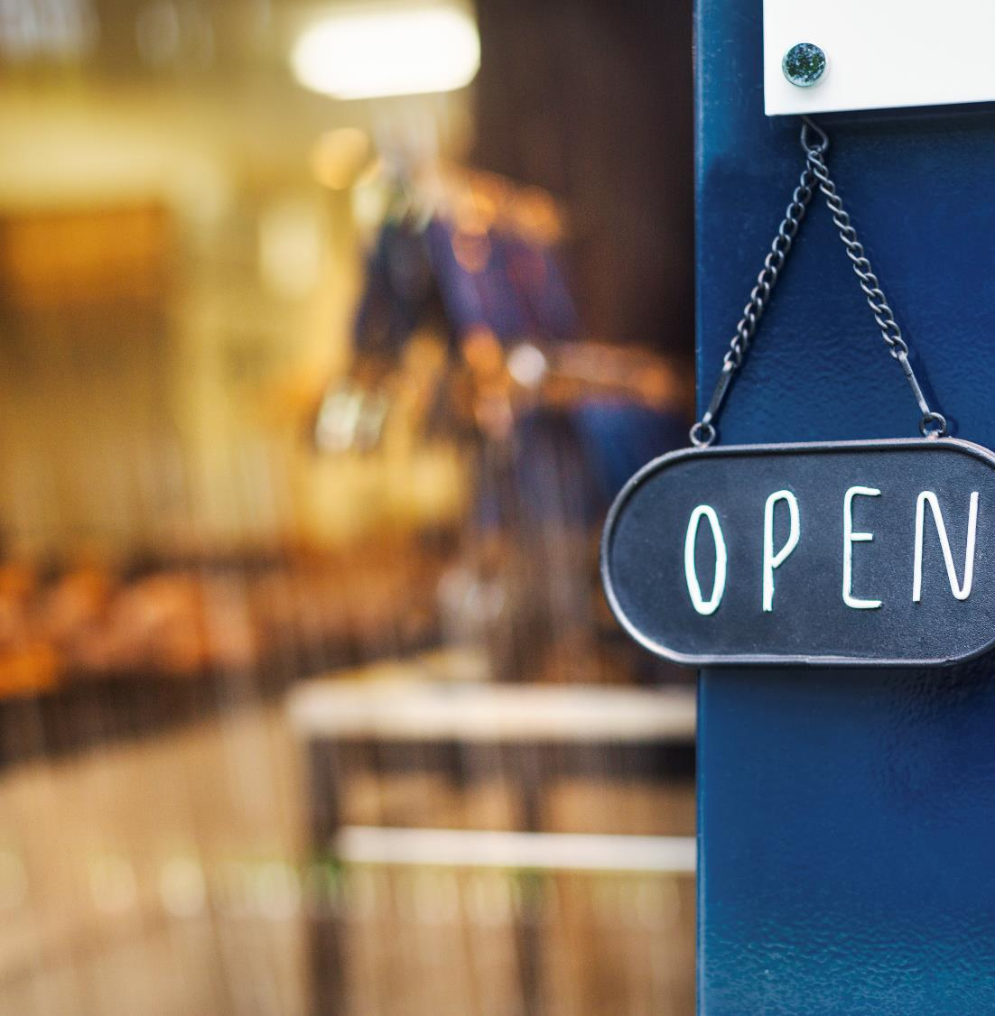
Thank you for your time

